Slide 1

Customer Inquiry Classification for Support Ticket Management
Efficient management and categorization of customer inquiries is crucial for providing timely responses and improving customer satisfaction in a support environment. This system aims to leverage Natural Language Processing (NLP) to automate the classification of customer inquiries.

Slide 2

The Need for Automated Customer Inquiry Classification
1
High Volume of Inquiries
2
Timely Responses
Organizations receive a vast number of customer inquiries daily, making manual classification challenging and time-consuming.
Prompt classification is crucial for providing customers with quick and relevant support to improve satisfaction.
3
Consistent Categorization
Automated classification ensures inquiries are routed to the appropriate teams and handled consistently.

Slide 3
Leveraging Natural Language Processing (NLP) for Classification
Text Analysis
Machine Learning
Contextual Understanding
NLP techniques analyze the text of customer inquiries to identify key topics, intents, and entities.
Classification models are trained on historical data to learn patterns and automatically categorize new inquiries.
Advanced NLP models can capture the broader context and intent behind customer requests.

Slide 4
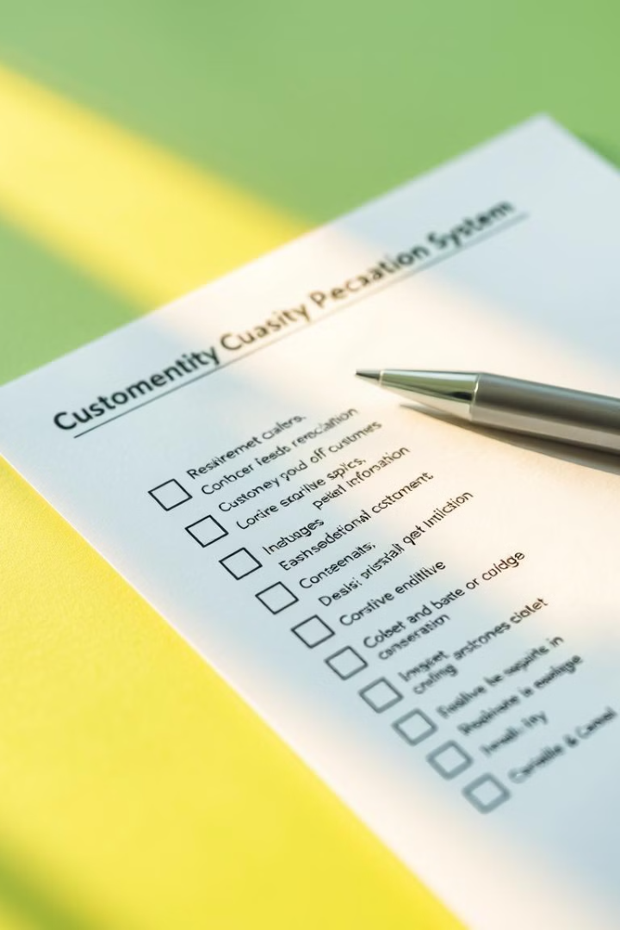
Key Features and Requirements
Multi-label Classification
Scalability
Ability to assign multiple categories to a single inquiry to capture its complexity.
Handle high volumes of inquiries with low latency and maintain accurate classifications.
Customizable Taxonomy
Explainable Predictions
Flexible to adapt to an organization's specific support categories and workflows.
Provide insights into the reasoning behind the automated classifications.

Slide 5

Developing and Training the NLP-based Classification Model
1
Data Preparation
Collect and preprocess a diverse dataset of historical customer inquiries and their corresponding classifications.
2
Model Selection
Choose an appropriate NLP-based classification algorithm, such as Transformer-based models, that can handle the complexity of customer inquiries.
3
Model Training
Train the selected model on the prepared dataset, fine-tuning and optimizing its performance through iterative cycles.

Slide 6




Deployment and Real-World Impact
Faster Response Times
Automated classification enables prompt routing of inquiries to the right support teams.
Improved Efficiency
Reduces manual effort and frees up support agents to focus on more complex issues.
Enhanced Customer Satisfaction
Customers receive timely and relevant support, leading to higher satisfaction and loyalty.

Slide 7

Conclusion
The implementation of an Automated Customer Inquiry Classification System leveraging NLP technology has demonstrated significant benefits in terms of efficiency, responsiveness, and customer satisfaction. This solution empowers organizations to provide exceptional support services while optimizing their resources.

